Slide 1
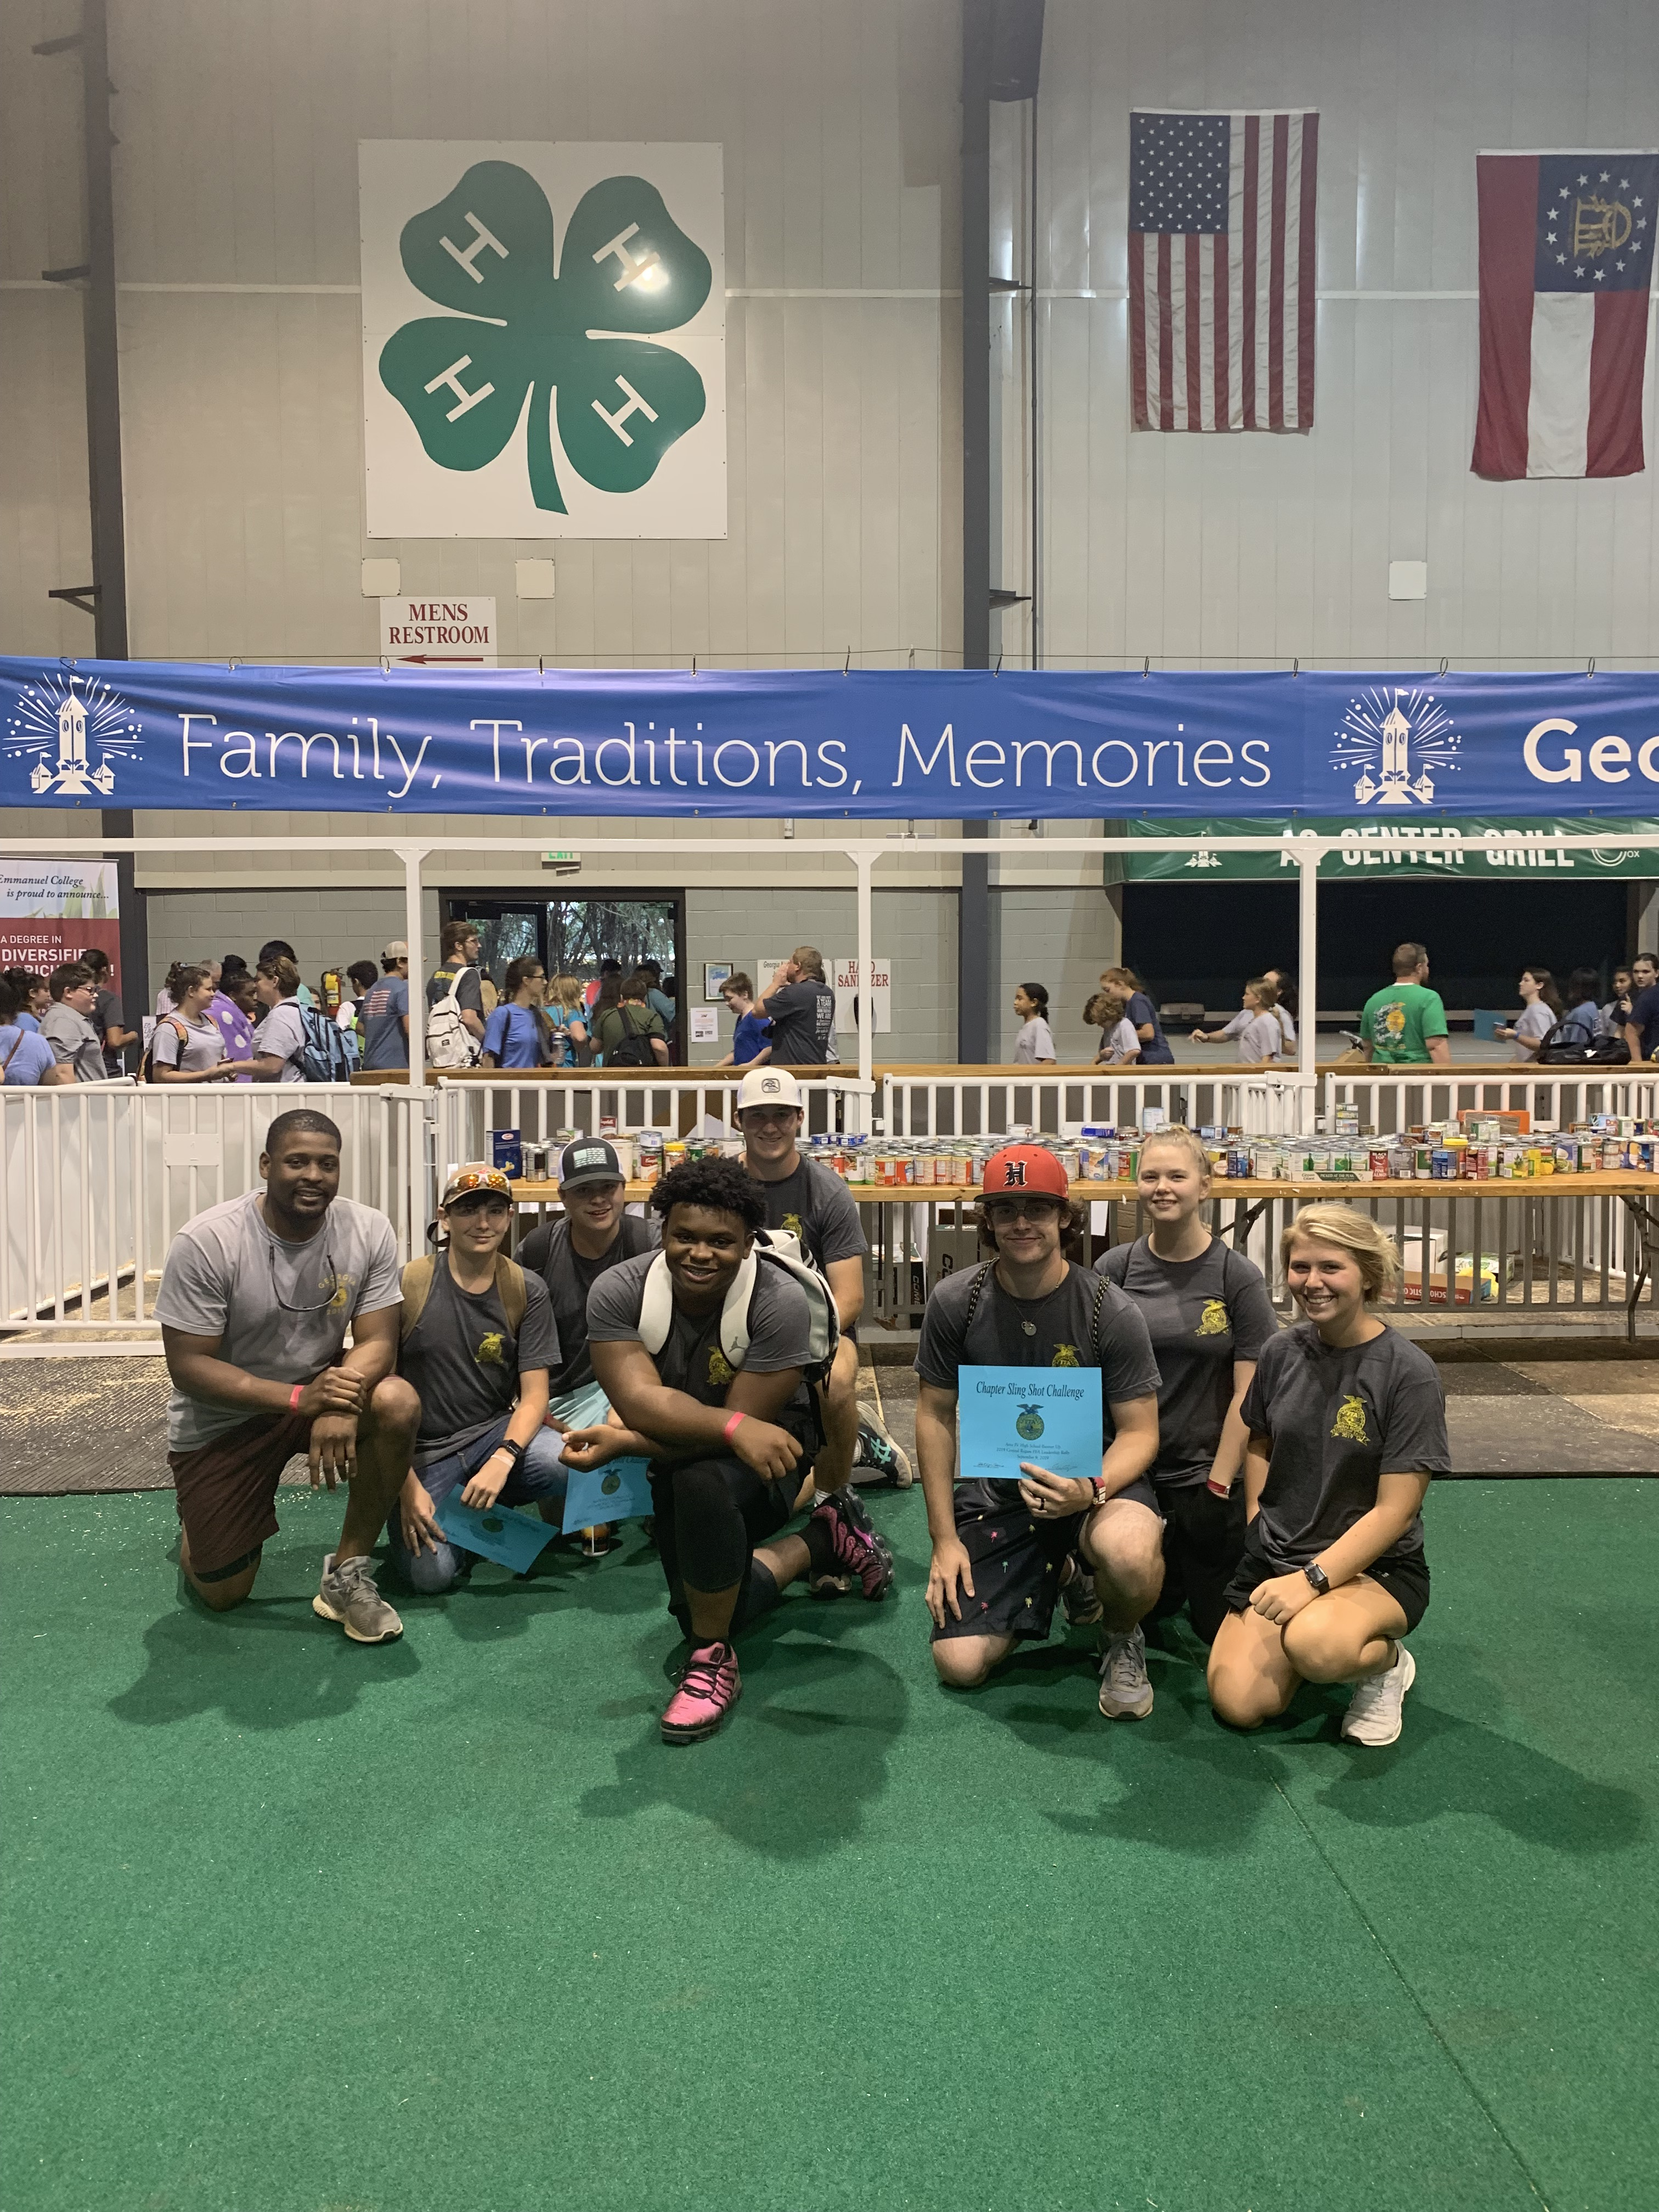
Hephzibah High School FFA 2019

Slide 2
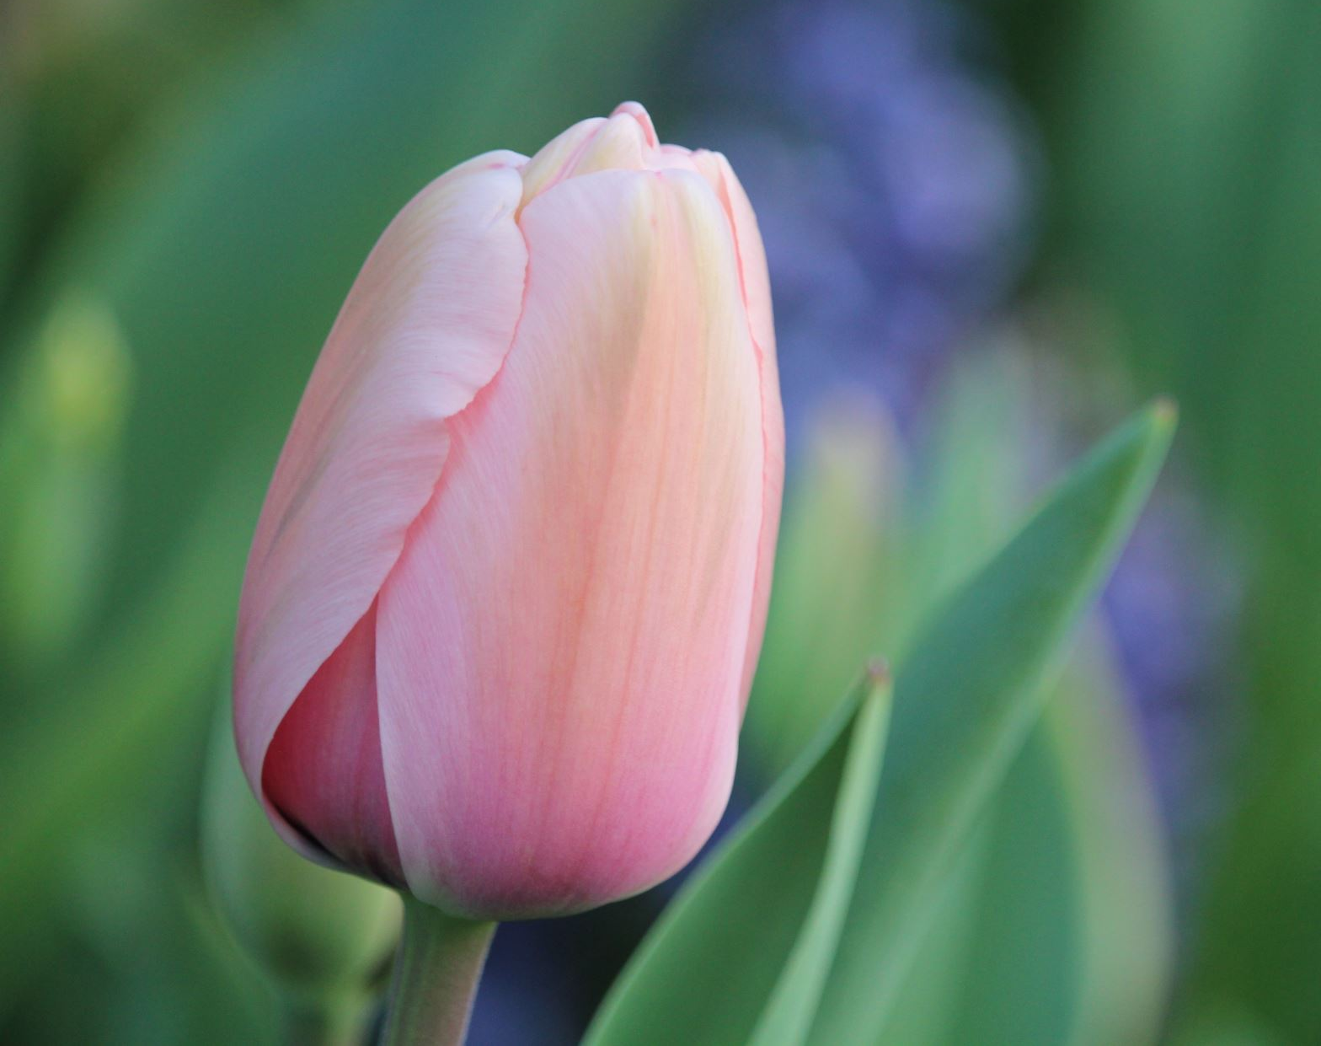
August

Slide 3
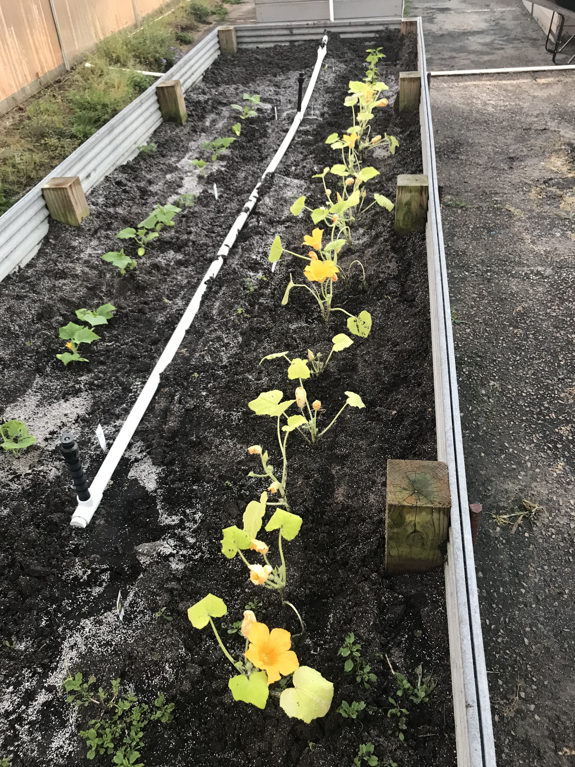
Learned the FFA Creed (took approximately 3-4 weeks)
Cleaned up the greenhouse and raise-beds
Introduced SAE Project

Slide 4

September

Slide 5
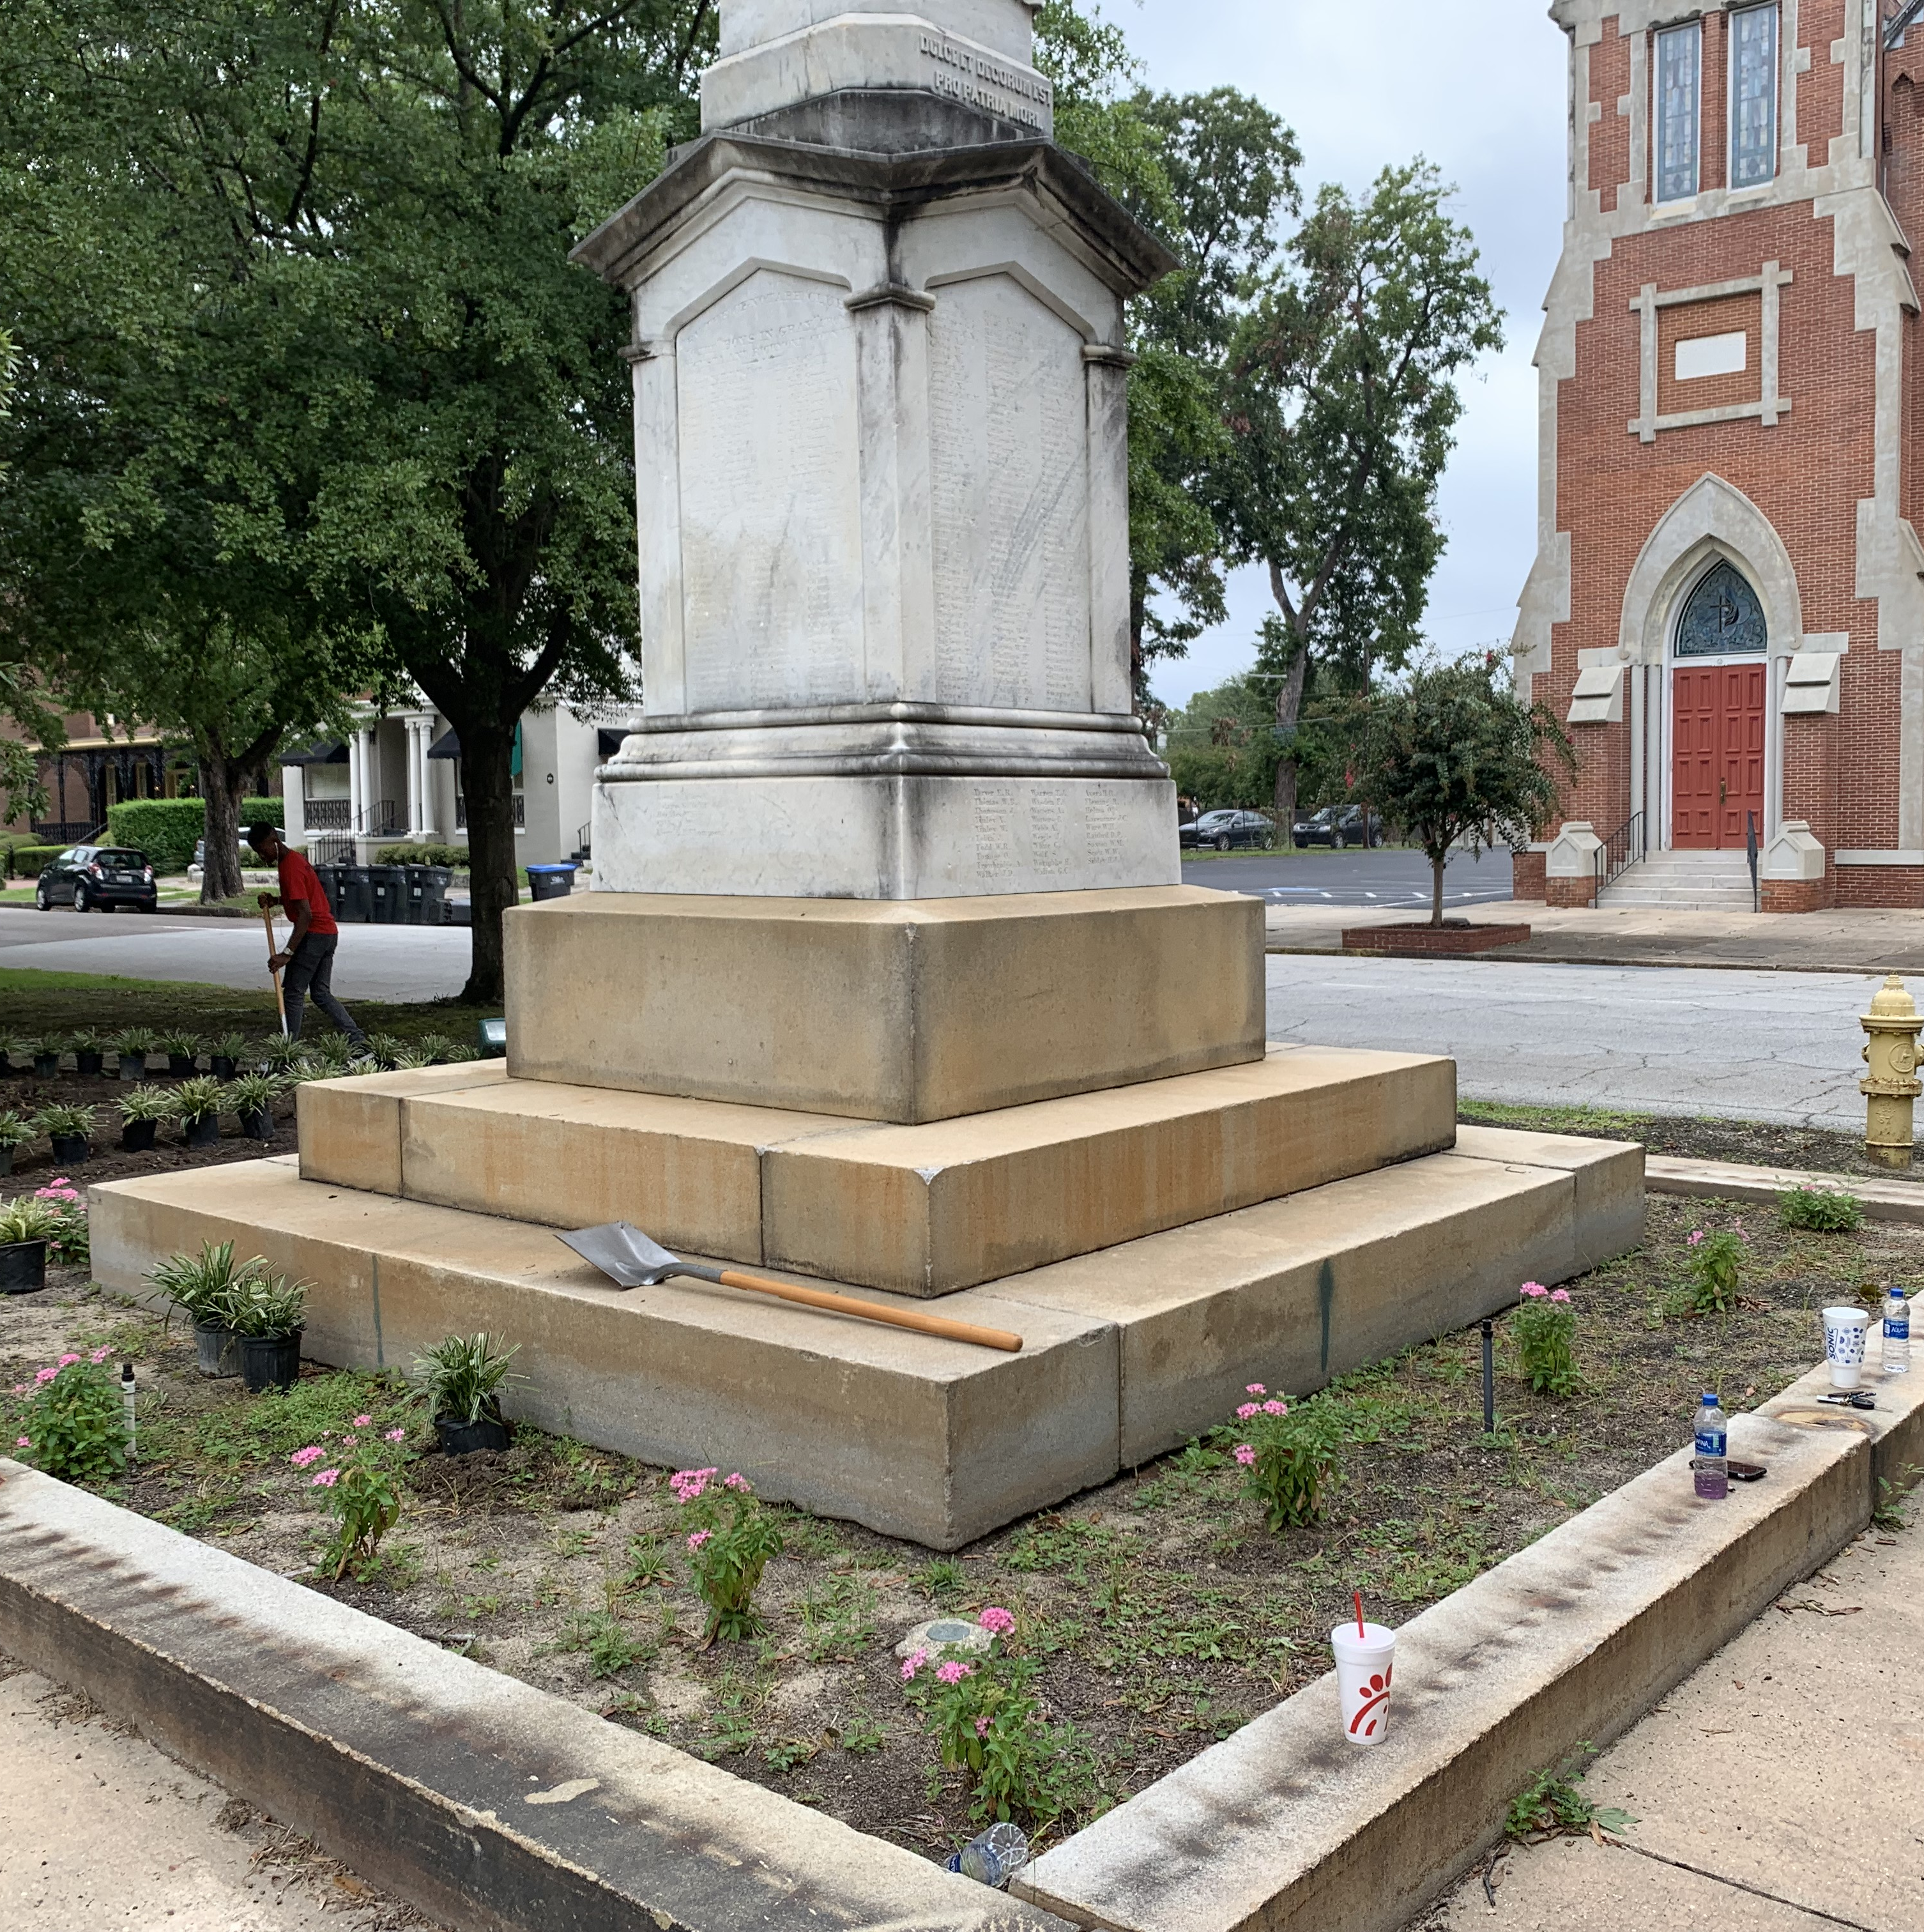
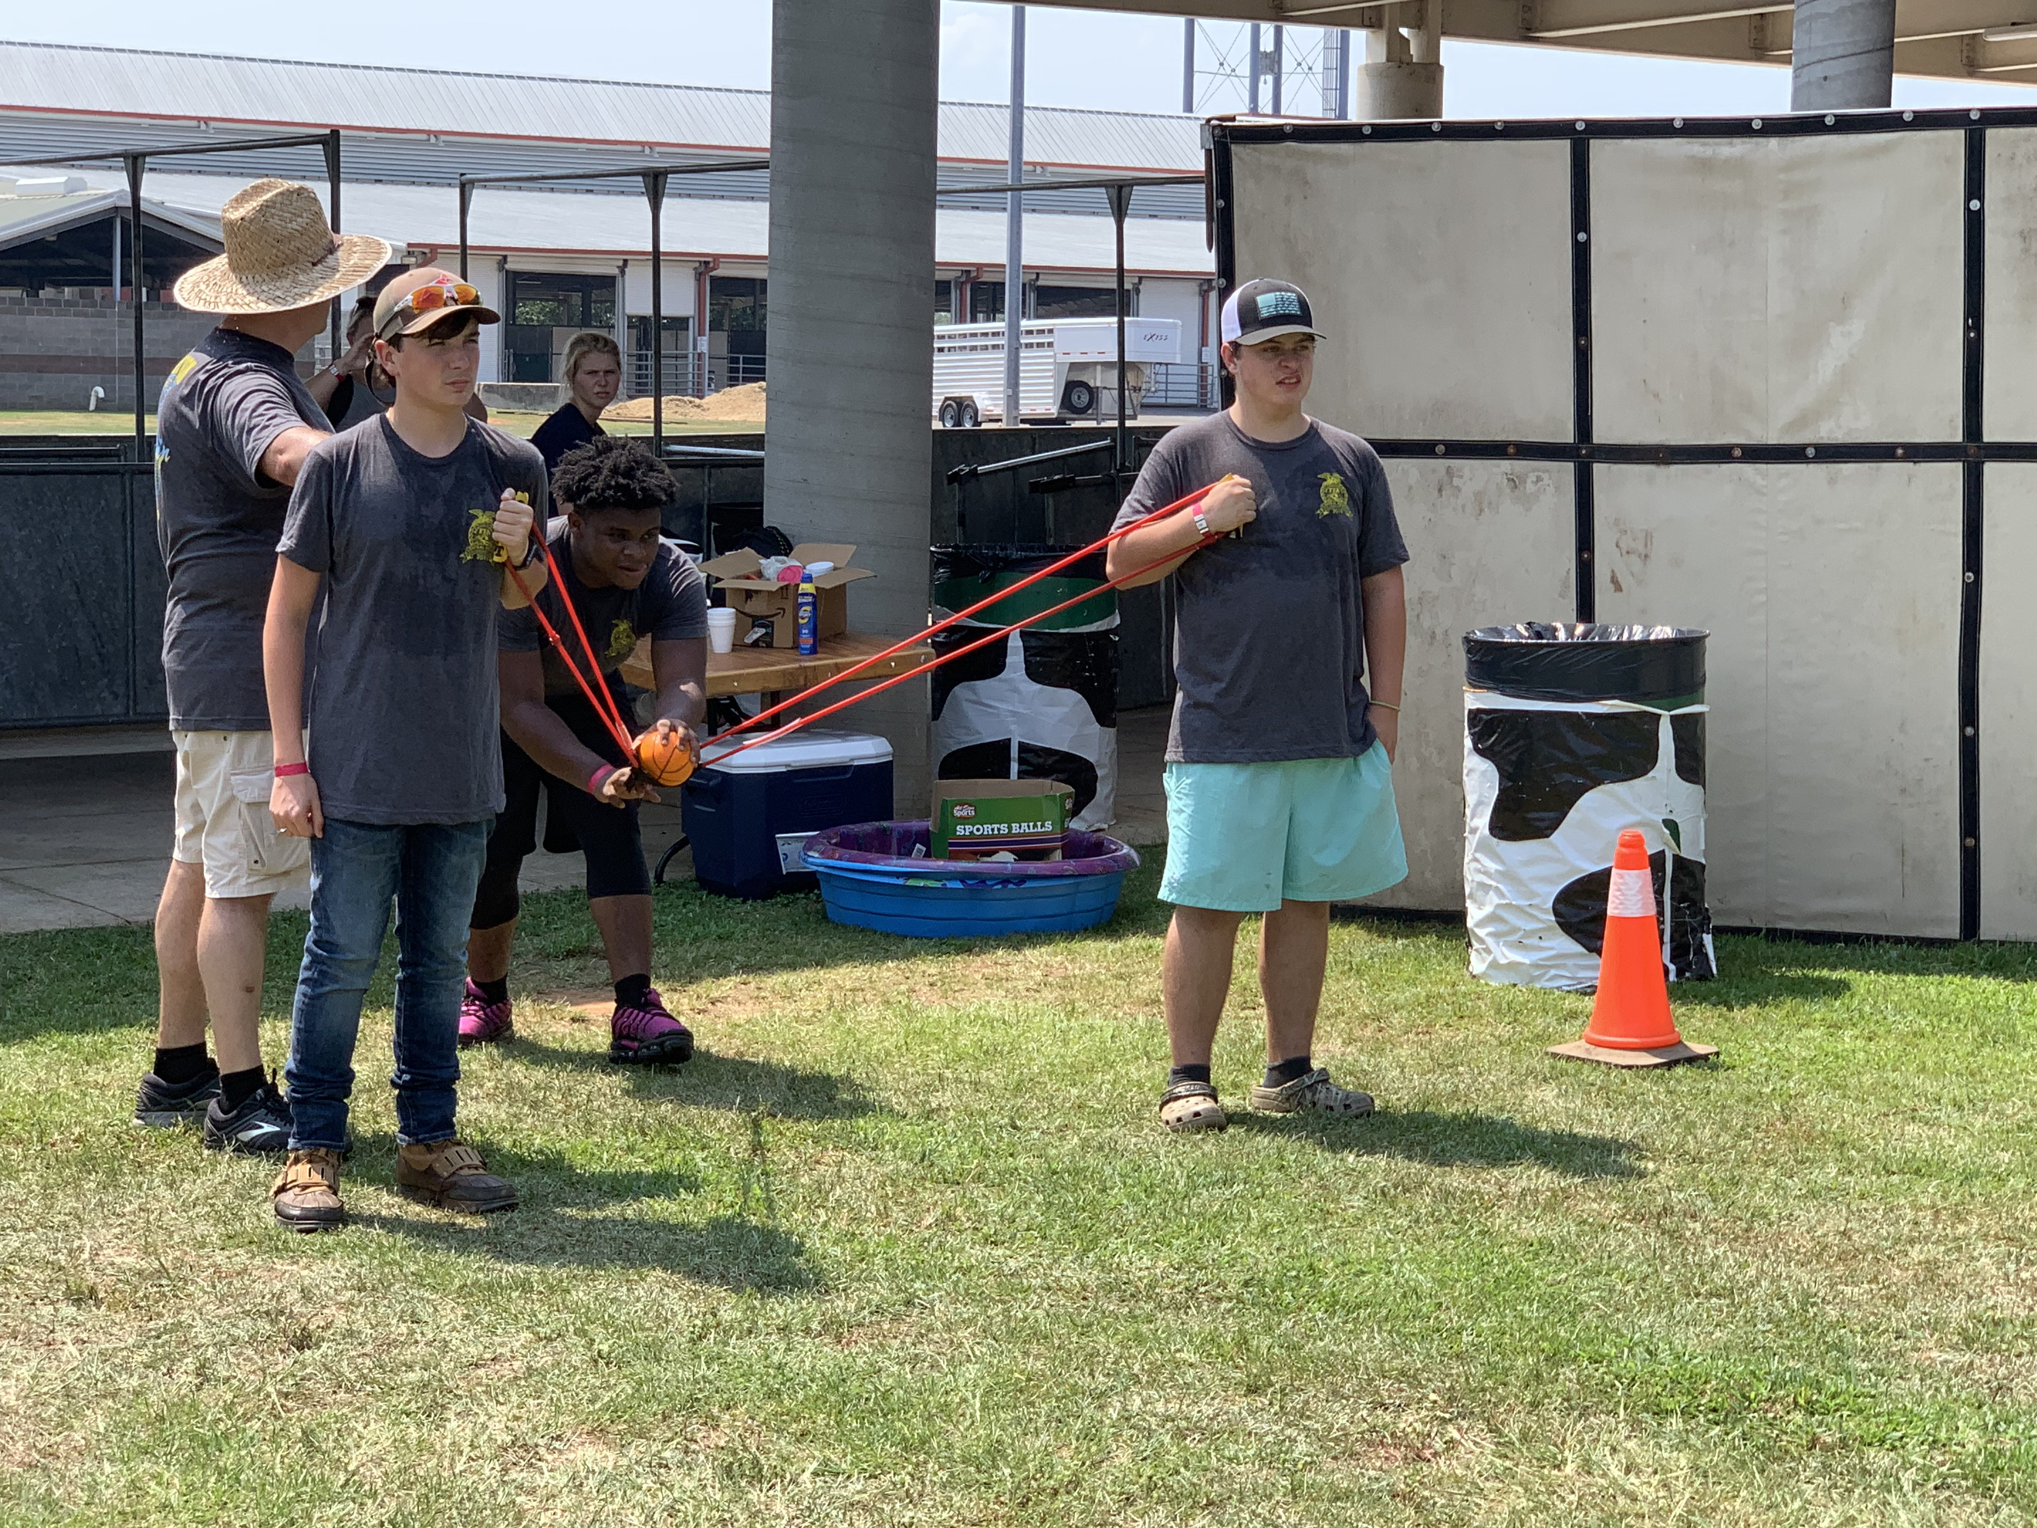
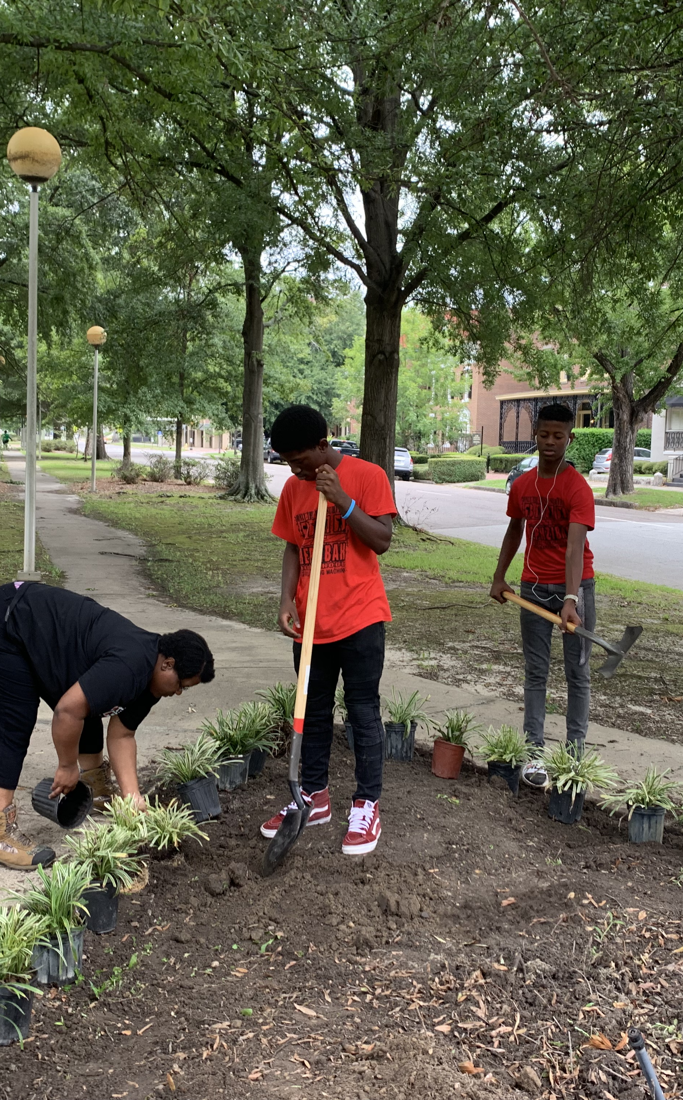
Took Food Safety notes (3-4 weeks)
Keep Augusta Beautiful downtown
FFA Rally in Perry, GA.
Helped organize the food supply closet, clothes, and shoes

Slide 6

October

Slide 7
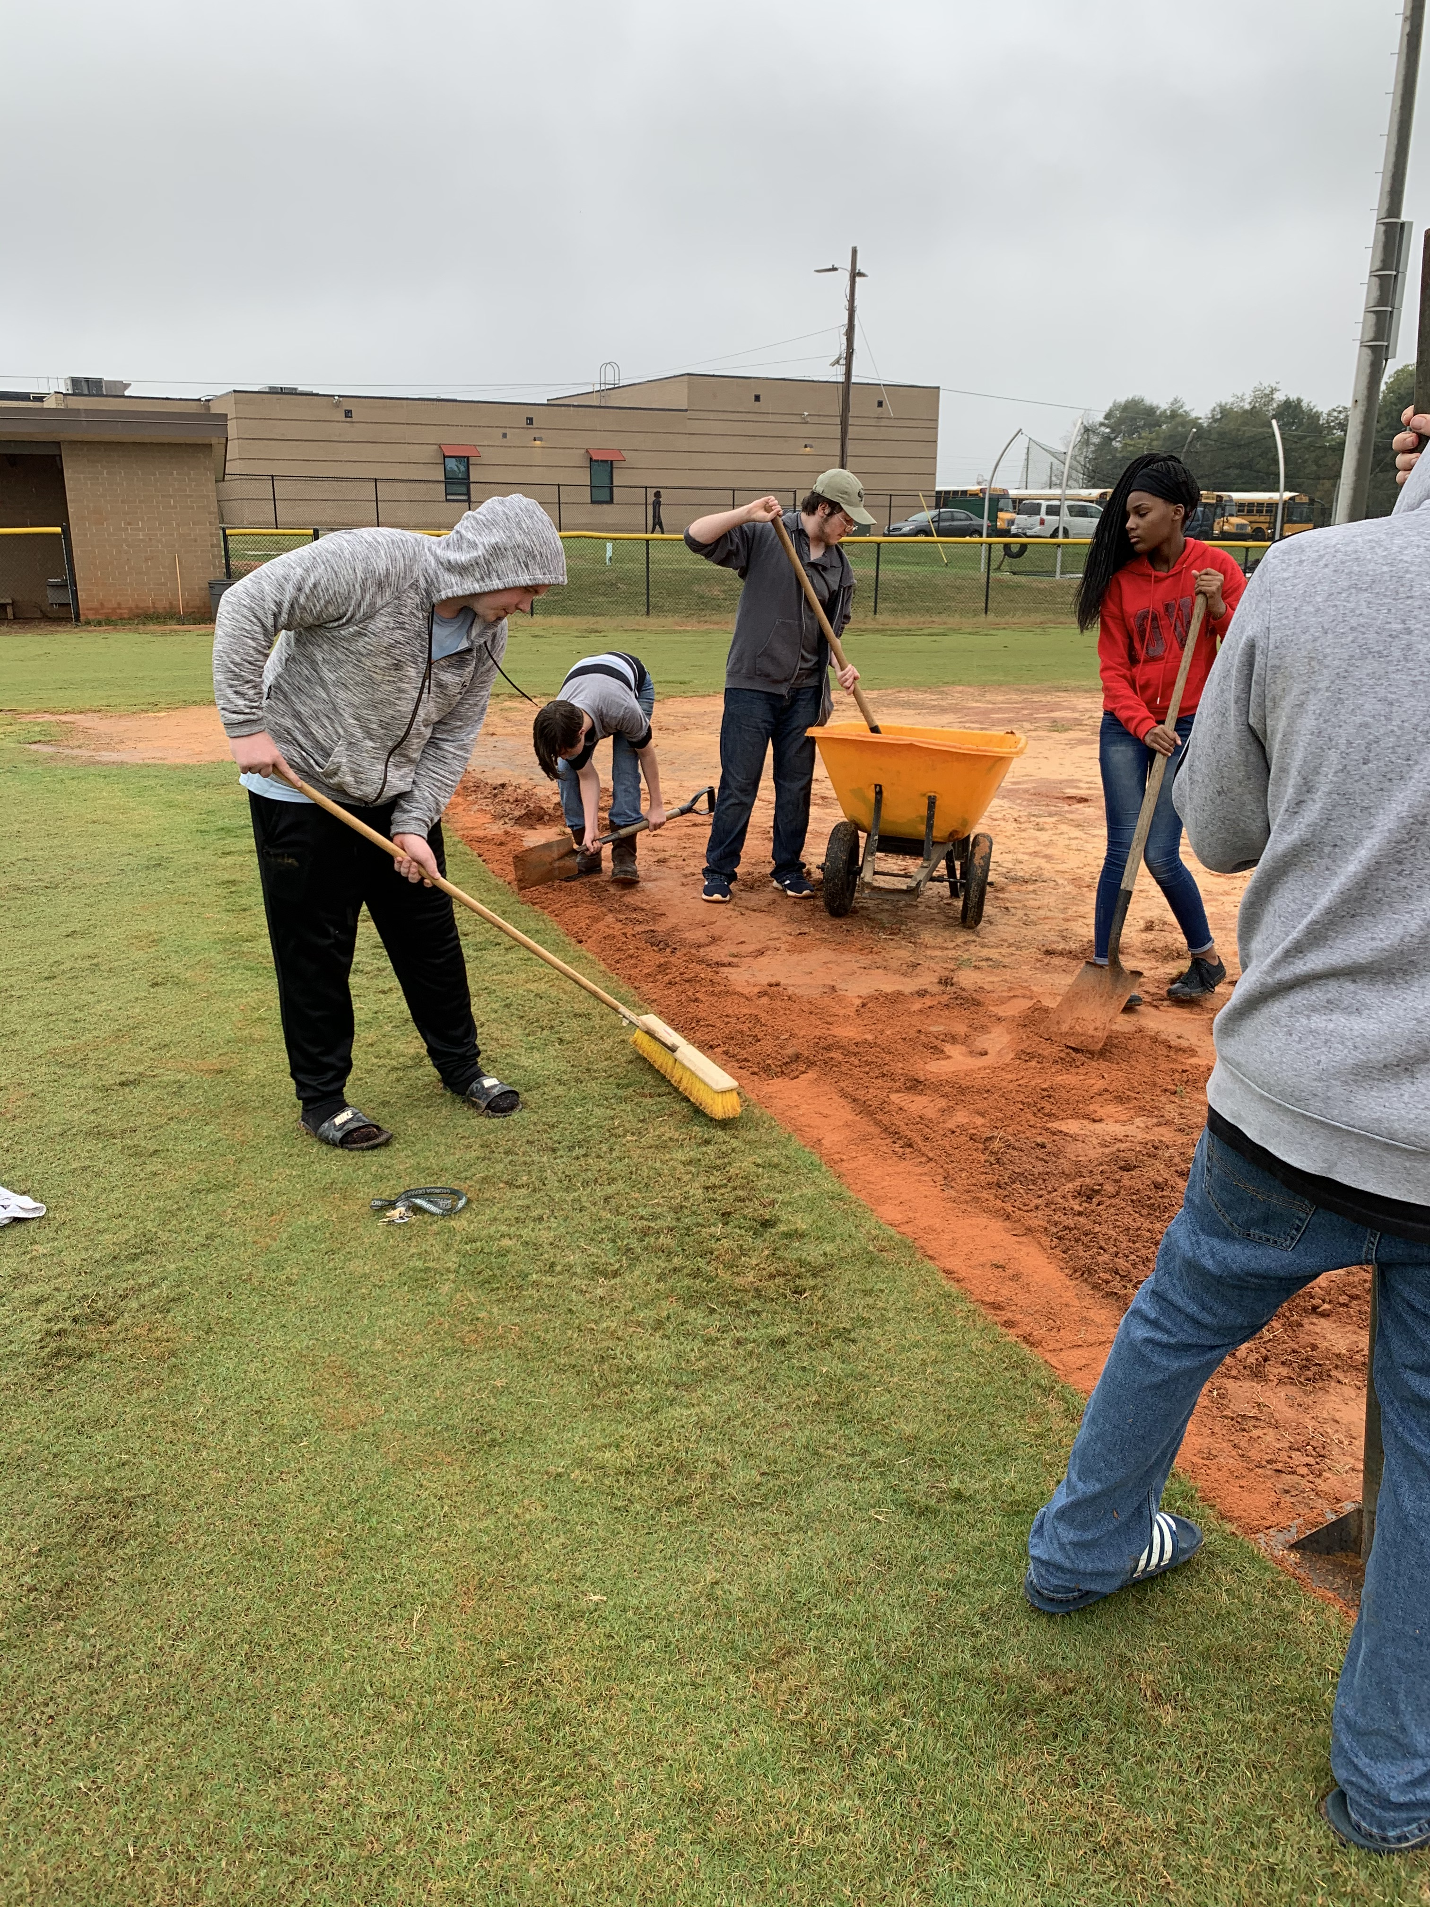
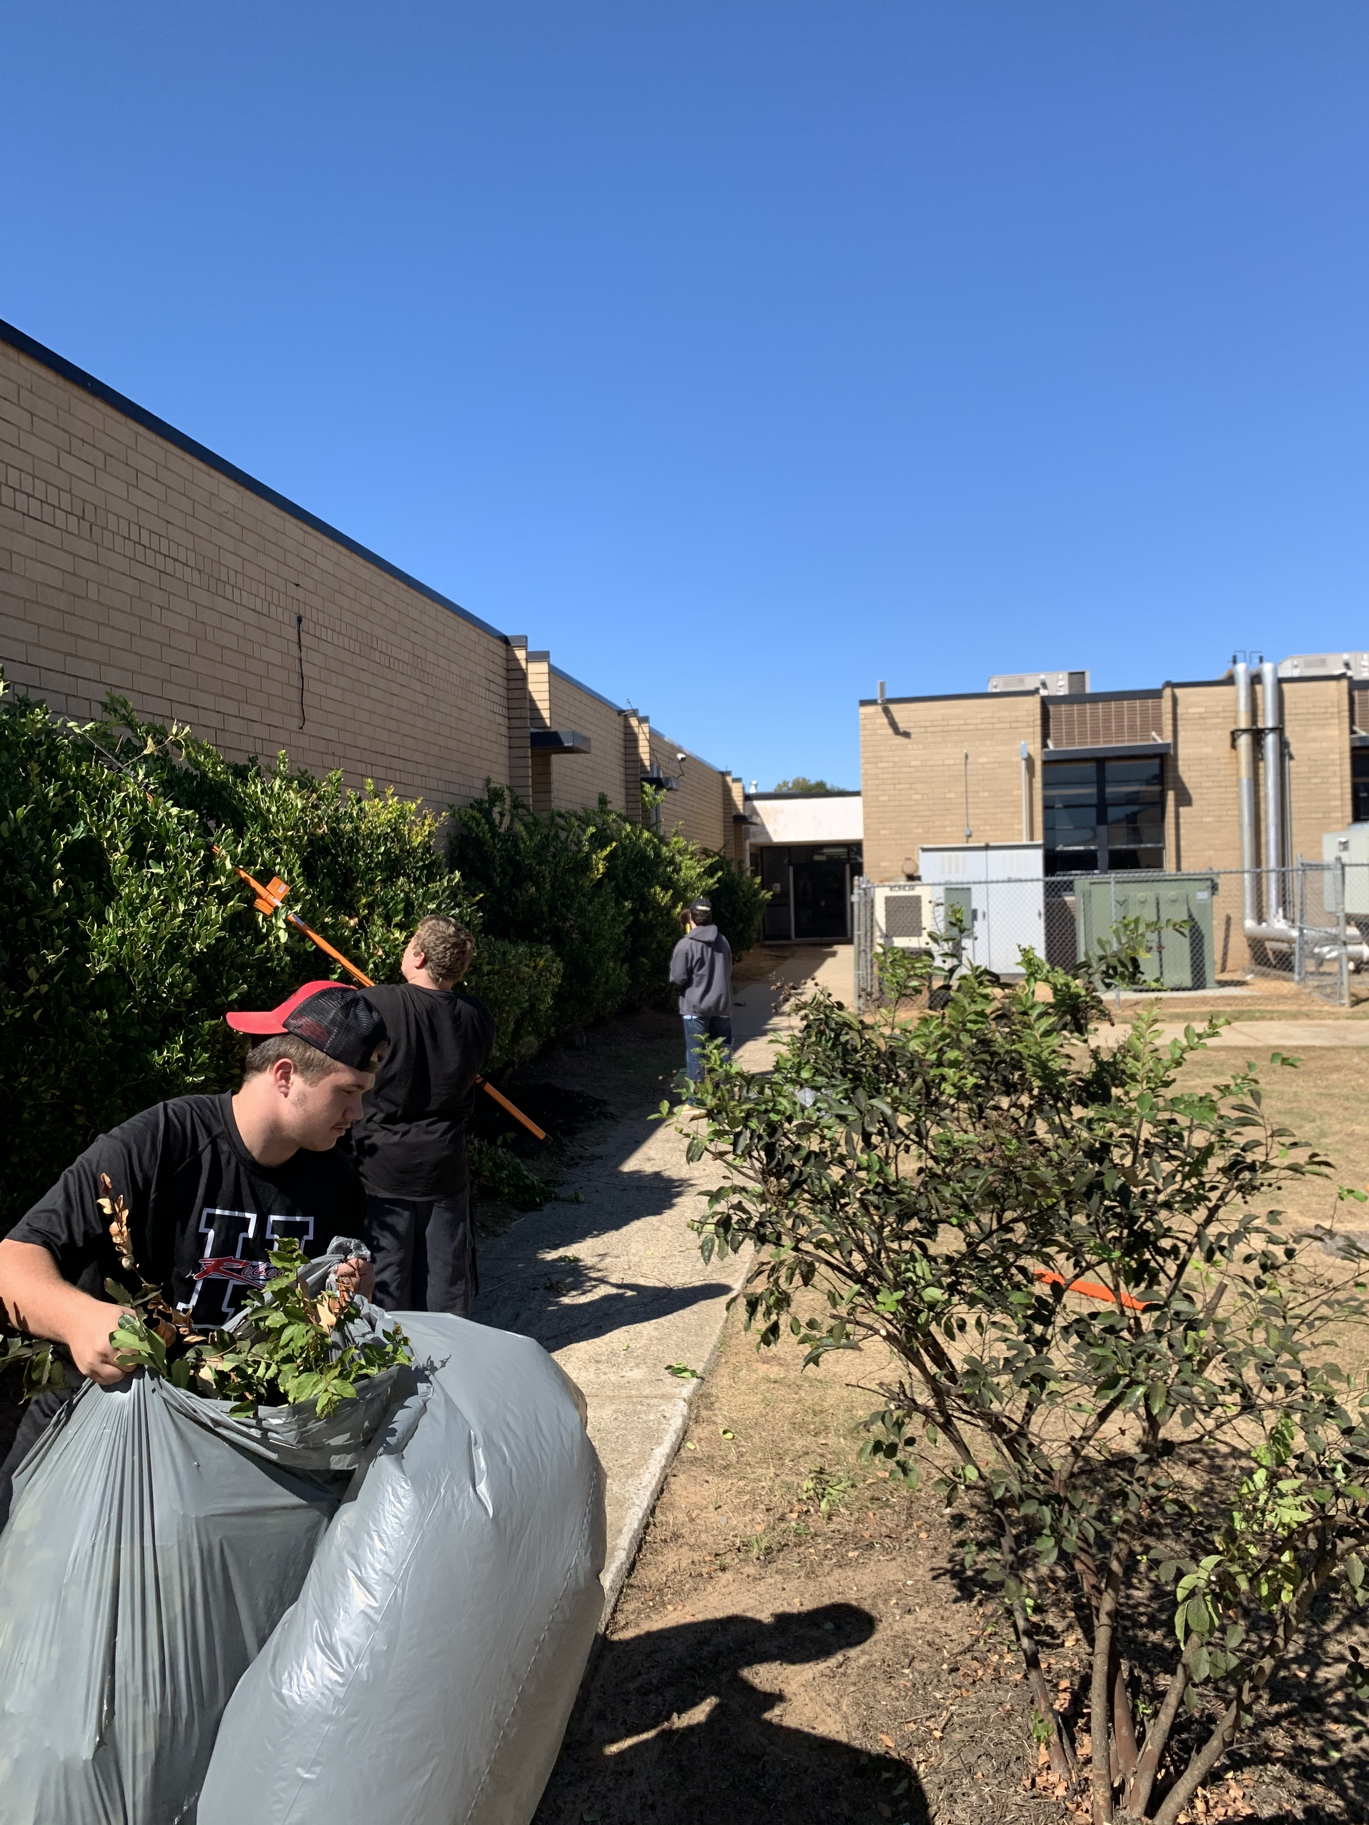
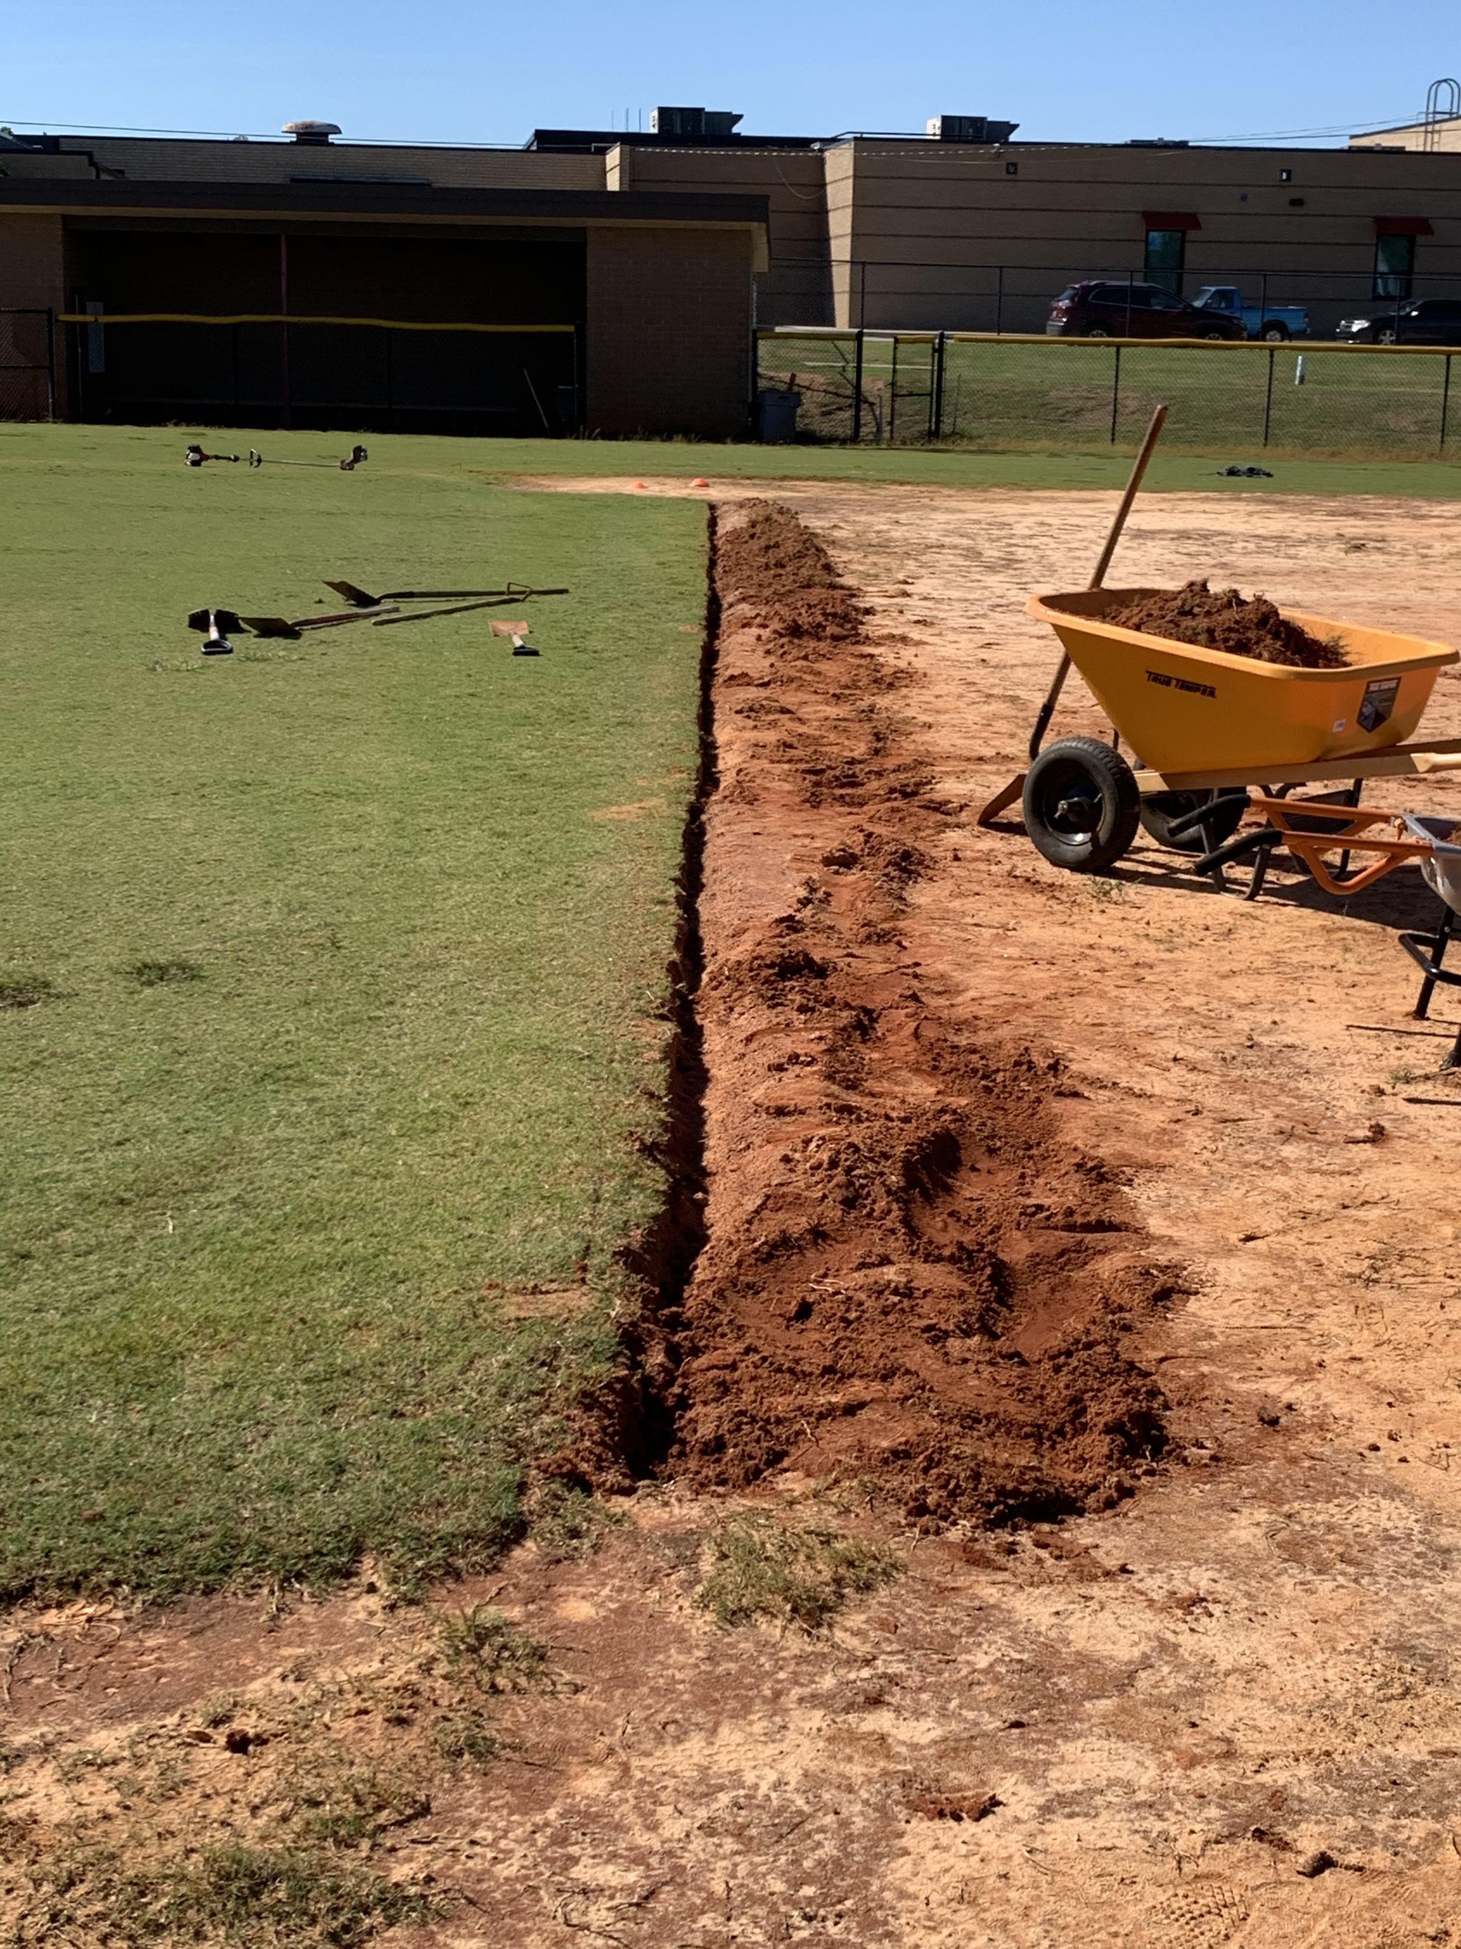
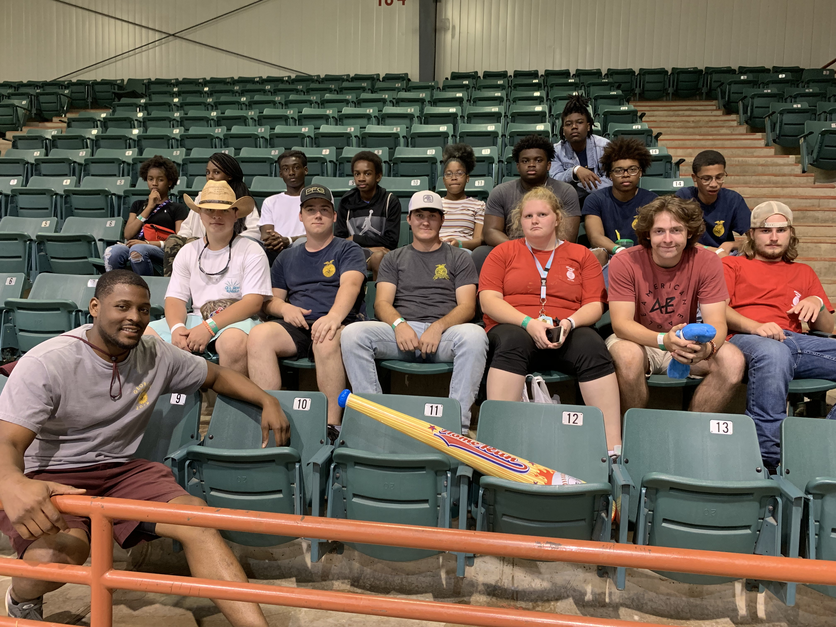
Went to the fair in Perry, GA
Took SAE notes
Got soil from the shed, put it around the bushes in the library courtyard, and planted flowers as well.
Sold cookies for fundraiser
Studied animal flash cards
Started working on the baseball field (added clay to the infield and making it even)
Trimmed the bushes to the CTAE area

Slide 8

November

Slide 9
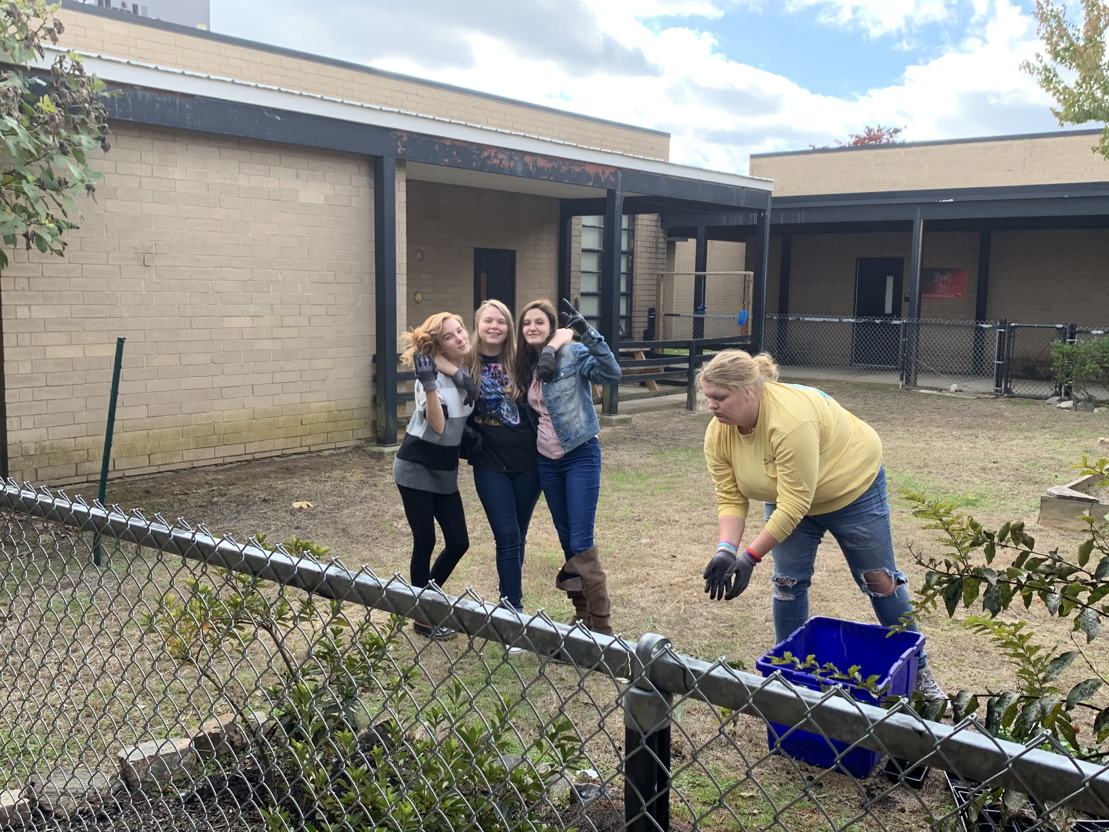
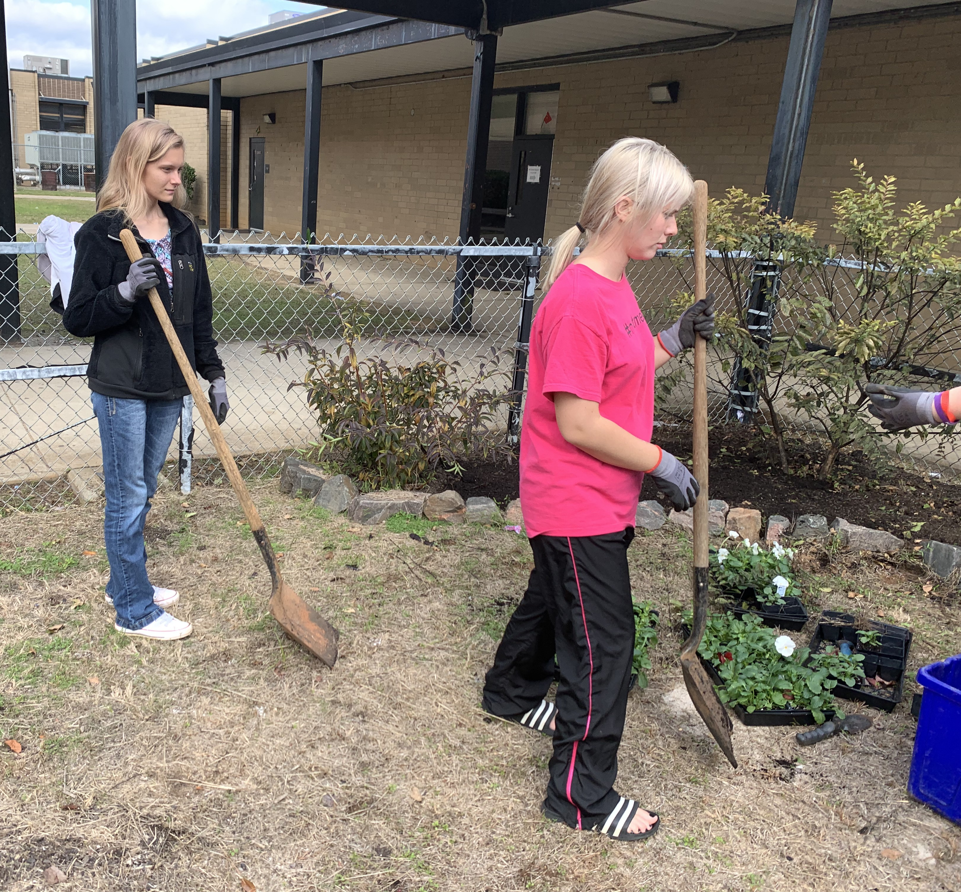
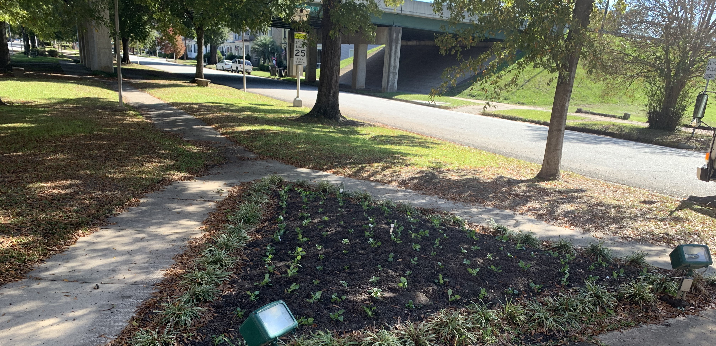
Went back downtown to finish planting flowers for Keep Augusta Beautiful.
Got extra clay from the baseball field and filled up a hole in the library courtyard.
Planted flowers in the Special Education courtyard
Studied plant flash cards
Went to Statesboro, GA for Floriculture competition

Slide 10

December

Slide 11
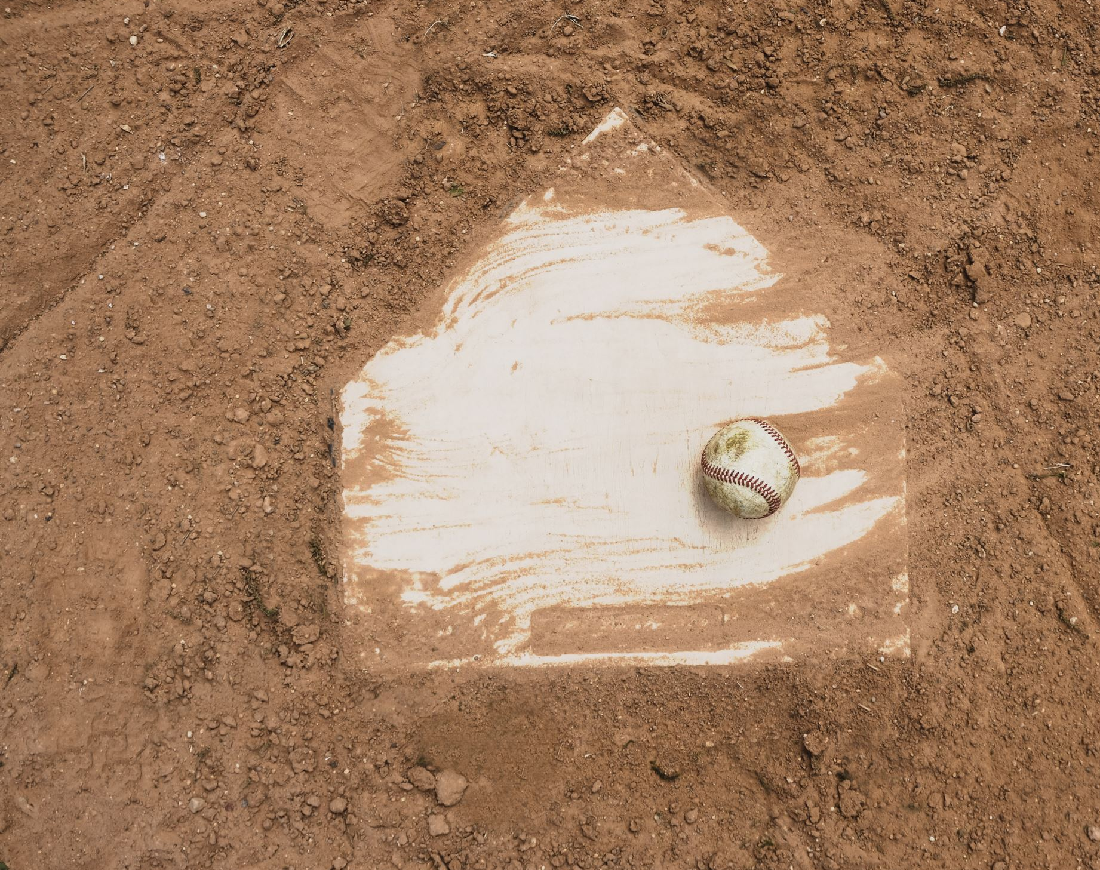
SAE due
Still working on the baseball field

